Slide 1
TOPIC MODELLING
TEAM – 3
ARPIT NAMDEO
RAJABHISHEK ADITYA
SAADIYA

Slide 2
BUSSINESS PROBLEM: Social event tracking and evolution framework to obtain the evolutionary trends of social events and generate effective event summary details over time. The input is the textual data collected from various social media. Based on the input data, our algorithm can learn multi-modality topics and track multiple events. After tracking, for each event, it can be visualized with texts and image over time.
BUSSINESS OBJECTIVE: Create the topics as different clusters and then whenever a new data is passed, the model should classify to which cluster the article belongs to.

Slide 3
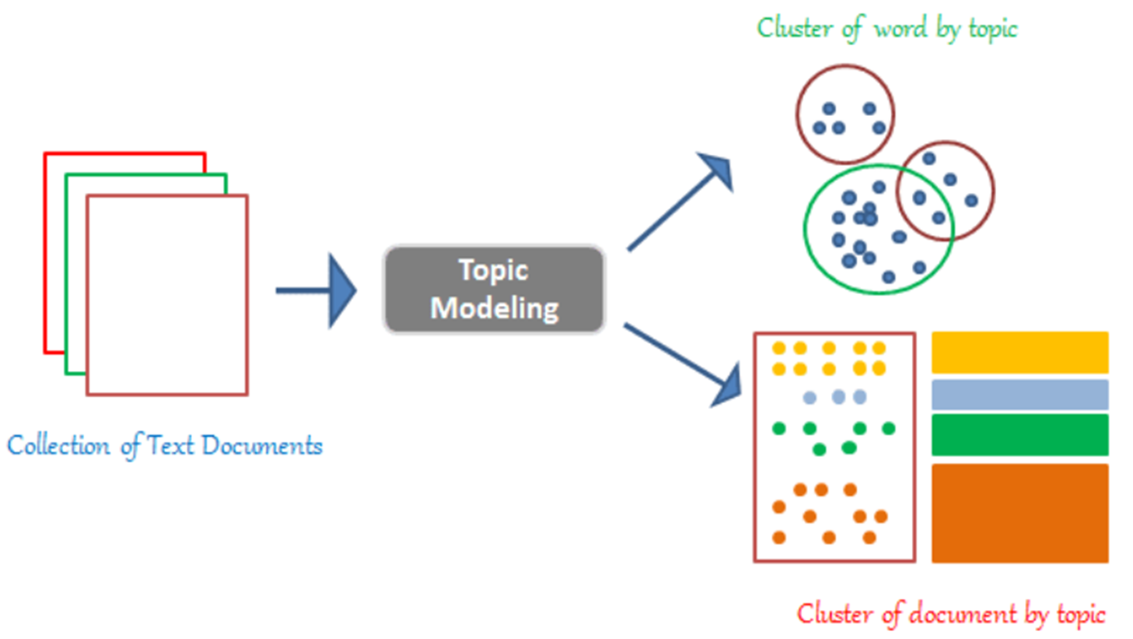
Project workflow

Slide 4
DATASET DETAILS
WEB SCRAPPING:
A TECHNIQUE OF EXTRACTING RAW DATA FROM WEB.
PYTHON PACKAGES LIKE BEAUTIFUL SOUP, REQUESTS AND URLLIB ARE USED.
DATASET IS FORMED BY WEB SCRAPPING THREE WIKIPEDIA PAGES.
DATASET IS COLLECTION OF TEXT DATA KNOWN AS CORPUS.

Slide 5
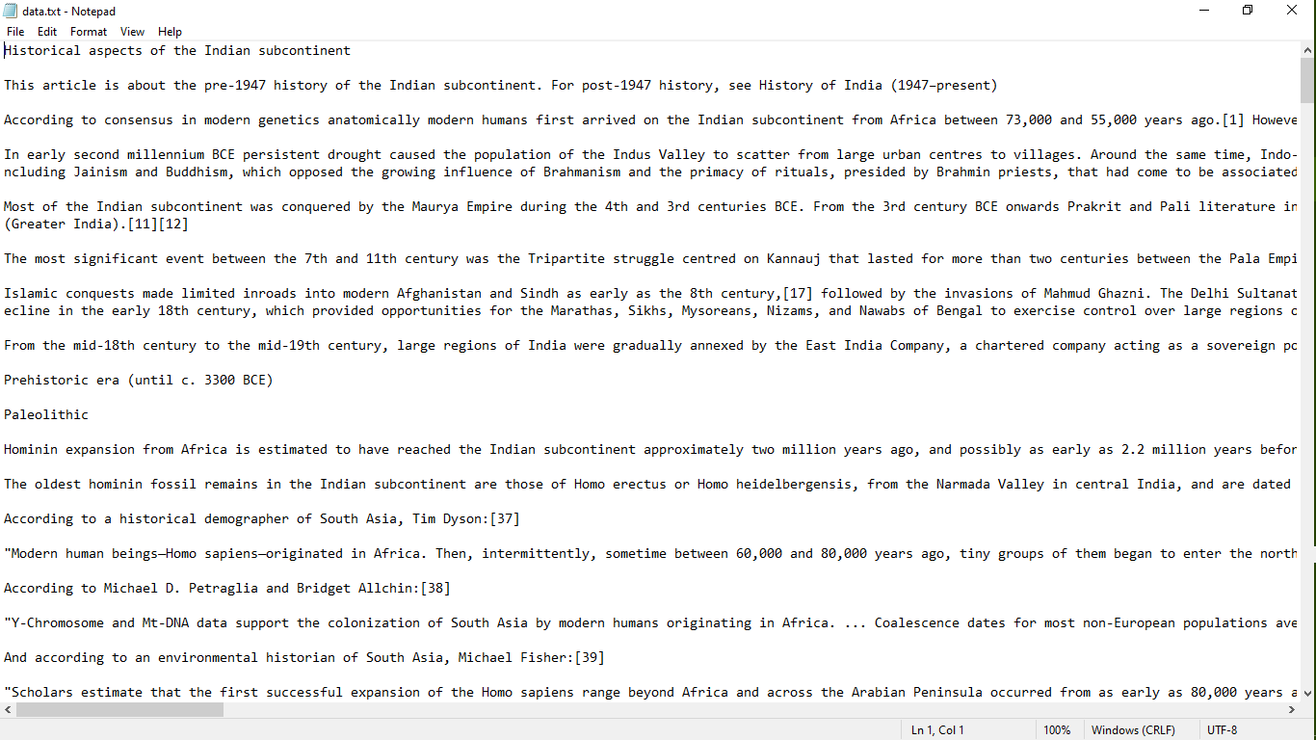
DATASET DETAILS:
SAMPLE DATASET IS AS FOLLOWS:

Slide 6
TEXT PRE-PROCESSING:
Preparing stop words:
Used “STOP_WORDS” from NLTK package.
Tokenize words and Clean-up text:
Tokenize each sentence into a list of words.
Remove punctuations and any unnecessary characters.
Used GENSIM’S “simple_preprocess()” .

Slide 7
TEXT PRE-PROCESSING:
Creating Bi-gram and Tri-gram models:
Bi-gram are two words frequently occurring together.
Tri-grams are three words frequently occurring together.
GENSIM’S “Phrase” model is used to build and implement bigrams and trigrams.
Lemmatization:
Grouping together different form of same word.

Slide 8
TOPIC MODELLING
Two main inputs to LDA model are dictionary (id2word) and corpus.
Gensim creates a unique id for each word in the document.
No. of topics = 6

Slide 9
MAR
WATER
SURFACE
EARTH
CRATER
LARGE
ICE
NAME
AREA
SMALL
DEFEAT
INDIA
TEAM
POINT
TOURNAMENT
YEAR
MANY
CONTAIN
MATCH
WAR
NAME
FEATURE
MAKE
OLYMPUS
VALLEY
MAP
NEW
ESTABLISH
PLAY
ALBEDO
MAR
CALL
CUP
IMPACT
COVER
CAP
POLE
MARTIAN
SIZE
HEMISPHERE
INDIA
EMPIRE
KINGDOM
COMPANY
MARATHA
LATER
SHOW
BECOME
EAST
HOWEVER
INDIA
NORTHERN
PERIOD
WORLD
SOUTHERN
DYNASTY
RULE
PLAIN
RESULT
EARLY
SPACE
SPORT
FEATURES
MARS
HISTORY
INDIA

Slide 10
Web Scraping:
Extracting the Raw Text Data from the WEB.
Python packages to be used are SCRAPY and JSON.
Topic Modelling:
Discovering the hidden themes in the collection.
Classifying the documents into the discovered themes.
Using the classification to organize/summarize/search the documents.
LDA from Genism package will be used
LDA - Latent Dirichlet Allocation

Slide 11
LDA:
The word ‘Latent’ indicates that the model discovers the ‘yet-to-be-found’ or hidden topics from the documents.
‘Dirichlet’ indicates LDA’s assumption that the distribution of topics in a document and the
distribution of words in topics are both Dirichlet distributions.
‘Allocation’ indicates the distribution of topics in the document.
LDA assumes that each document is generated by a statistical generative process. That is, each document is a mix of topics, and each topic is a mix of words. It treats documents just as a collection of words or a bag of words.
Once the probabilities are estimated, finding the collection of words that represent a given topic can be done either by picking top ‘r’ probabilities of words or by setting a threshold for probability and picking only the words whose probabilities are greater than or equal to the threshold value.

Slide 12
LDA has three hyper parameters; 1) document-topic density factor ‘α’ 2) topic-word density factor ‘β’ 3) the number of topics ‘K’ to be considered.
The ‘α’ hyperparameter controls the number of topics expected in the document. Low value of ‘α’ is used to imply that fewer number of topics in the mix is expected and a higher value implies that one would expect the documents to have higher number topics in the mix.
The ‘β’ hyper parameter controls the distribution of words per topic. At lower values of ‘β’, the topics will likely have fewer words and at higher values topics will likely have more words. α and β are typically set below one.
The ‘K’ hyperparameter specifies the number of topics expected in the corpus of documents. Choosing a value for K is generally based on domain knowledge. An alternate way is to train different LDA models with different numbers of K values and compute the ‘Coherence Score’. Choose the value of K for which the coherence score is highest.

Slide 13
